Slide 1


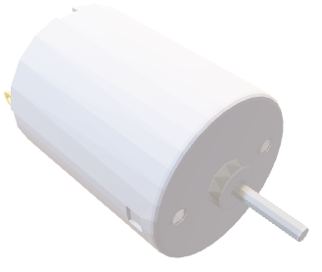

Tree network + JTAG line.
Compiler can create
the routing table for PCBs.
Hub can be flashed, cards separated,
without any change to the code.
Isolation works when separated.
Suitable for network where the
branches does not talk to each other with high bandwith.
 | JTAG | XL7
XL0 | XUF216 | XL6
XL1 | USB | XL5
 | JTAG | XL4
8
X-AXIS2
IDC
 | JTAG | XL7
XL0 | XUF216 | XL6
XL1 | USB | XL5
 | JTAG | XL4
3
IO1
IDC
COLOR = ACTIVATED
 | JTAG | XL7
XL0 | XUF216 | XL6
XL1 | USB | XL5
 | JTAG | XL4
HEAD C1
2
IDC
Tested with 9 PCBs in tree + XTAG line. Full JTAG debug.
Realtime Stdout over UART.
Compiles and runs in the simulator.
 | JTAG | XL7
XL0 | XUF216 | XL6
XL1 | USB | XL5
 | JTAG | XL4
HEAD C0
1
IDC
HEAD Z
 | JTAG | XL7
XL0 | XUF216 | XL6
XL1 | USB | XL5
 | JTAG | XL4
0
Y-AXIS
IDC
HUB
 | JTAG | XL7
XL0 | XUF216 | XL6
XL1 | USB | XL5
 | JTAG | XL4
0
6
IO1
X
Y
7
1
2
IO2
X2
Z
C0
X-AXIS
IDC
C1
 | JTAG | XL7
XL0 | XUF216 | XL6
XL1 |  | XL5
 | JTAG | XL4
4
3
5
8
9(Not shown) IO2-card
IDC
7
FLASH XL3 | JTAG | XL7
XL0 | XUF216 | XL6
XL1 |  | XL5
USB XL2 | UART JTAG | XL4
6
PC
5
4
IDC
HUB
XTAG UART
Boots over JTAG or from Flash

